Slide 1
Combating Noise in the Workplace in 2023
Presentation by Serge Beaulieu
Occupational Health and Safety Lecture
UNDE
March 11, 2023

Slide 2
Noise in numbers
In industrialized countries, the prevalence of hearing loss attributable to occupational noise exposure is estimated to be 10 to 16% (Dobie 2008).
In the United States, approximately 10% of workers are exposed to noise levels above 90 dBA every day (Driscoll et al., 2010).
In Quebec, the Eqcotesst survey (2011) estimated that 359,000 workers work -- often or all of the time -- in such intense noise that it is difficult to carry on a conversation at a distance of one meter, even while shouting (noise level estimated at more than 85 dBA according to Harris, 1979)

Slide 3
The number of cases of occupational deafness recognized in Quebec by the CNESST (2007-2017=+205%)
Average 1996-2006: 2590 cases of occupational deafness / year
Source: DCGI-Rapport lésions acceptées au 31 juillet de l’année suivant l’année d’inscription [DCGI-Injury report accepted on July 31 of the year following the year of registration]

Slide 4
Average annual growth rate: 14.1%
Major sources of disbursement: hearing aids
($74.3M 46% of disbursements) and APIPP ($75.9M 47.1%)
Changes in costs of occupational deafness (2007-2017)

Slide 5
Distribution of accepted cases: infra- vs. supra-threshold
% cases
Infra-threshold (without APIPP): 2007 = 19.6 %; 2017 = 29.7 %
Supra-threshold (with permanent damage): 2007 = 80.4 % 2017 = 70.3 %

Slide 6
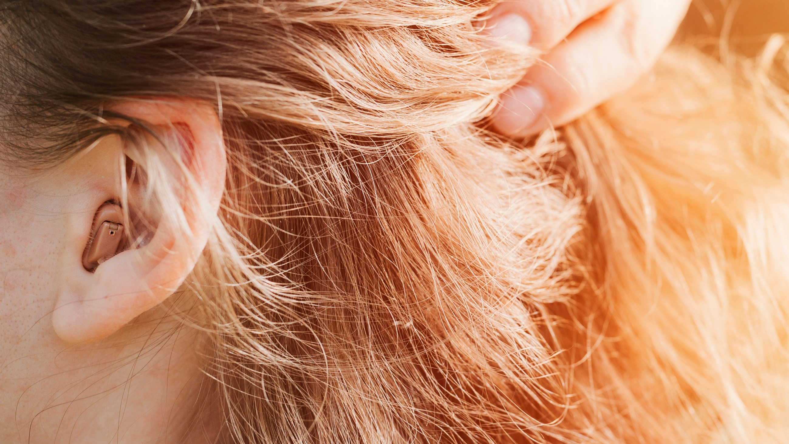
Anatomy of the auditory system

Slide 7
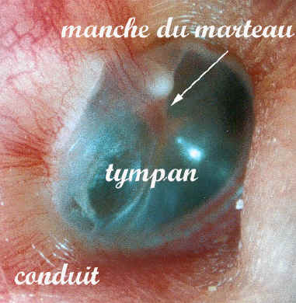
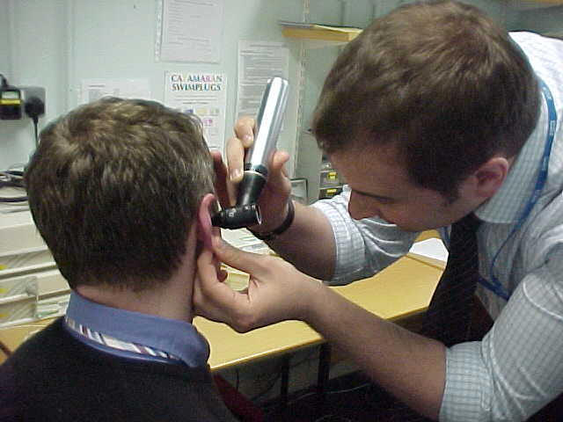
What can be seen and is not affected by noise:
the eardrum and ossicles
Demonstration
Otoscopy video

Slide 8
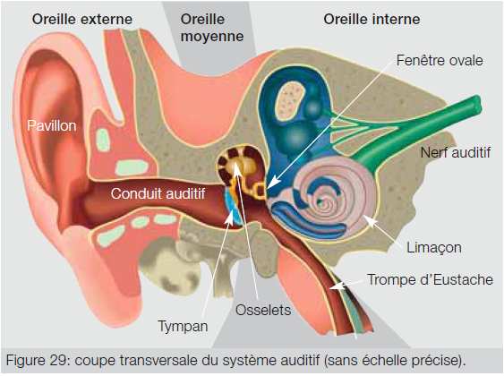

Slide 9
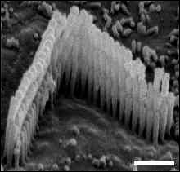
A normal ciliated cell
(Pujol et al, 1999)

Slide 10
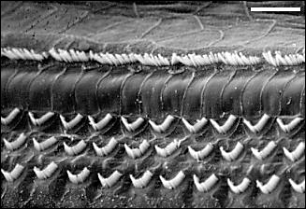
Normal inner ear
(Pujol et al, 1999)

Slide 11
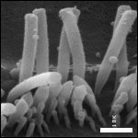
A ciliated cell following exposure to noise
(Pujol et al, 1999)

Slide 12
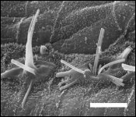
Pathological failure, permanent hearing loss
(Pujol et al, 1999)

Slide 13

Additional irritants
Ototoxic effects
  Chemical products
  Toluene
  Styrene
  Trichloroethylene
  Lead

Slide 14

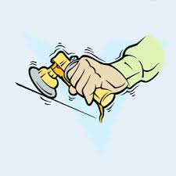
Additional irritants
Carbon monoxide
Physical factors (vibrations)
Organizational factors
  shifts longer than 8 hours
  overtime

Slide 15
Noise in the workplace:
A scourge
Approximately 100,000 workers exposed to noise levels above 90 dBA (the Quebec standard)
Contributes to industrial accidents
6.2% more likely to suffer an accident at work, over 7% if already deaf
Over 10% of all industrial accidents are associated with excessive noise

Slide 16
Noise in the workplace:
A scourge
Noise is a cause of fatal accidents in 2.2% of cases
Quebec would avoid at least 2,600 accidents per year if the standard were set at 85 dBA for 8 hours
Quebec standards are outdated
Source: University researchers in audiology at the UDM, Laval University and the INSPQ

Slide 17
Noise in the workplace: A scourge
It affects the productivity of businesses
Greater labour turnover
Decline in employee performance
Increased rate of absenteeism
Inconsistent productivity and quality

Slide 18

Noise in the workplace: A scourge
Higher insurance premiums
Costs related to personal hearing protection programs
Rise in industrial accidents
Early retirement
Deteriorating working environment

Slide 19
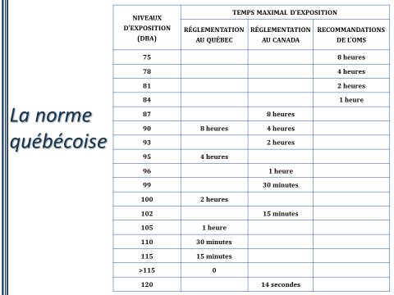

Slide 20
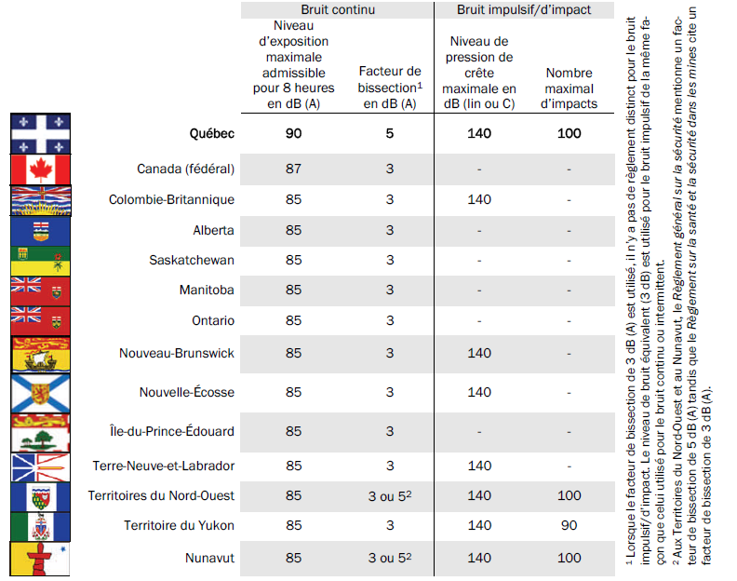
Sound level principle in Canadian regulations
Source: Soulard, 2010

Slide 21
Risk of compensable hearing loss based on exposure level
Average level of exposure in decibels (dBA) | Percentage of the population that will suffer from compensable hearing loss after 40 years of exposure
90 | 23 to 32
85 | 8 to 14
80 | 1 to 5
75 | ~ 0
Source: NIOSH (1995). Preventing Occupational Hearing Loss - A Practical Guide. Cincinnati, OH: U.S. Department of Health and Human Services, Public Health Service, Centres for Disease Control, National Institute for Occupational Safety and Health, DHHS (NIOSH), Publication No. 96-110

Slide 22
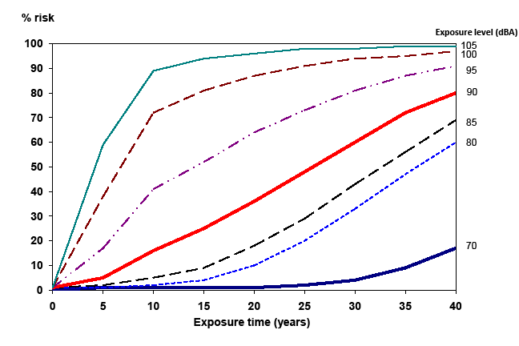
Percentage of expose workers
with hearing loss
Hearing loss ≥ 25 dBHL (500, 1000, 2000 Hz)
(Johnson & Morata, 2010)

Slide 23
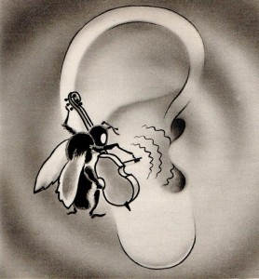
Adverse health effects…
Stress
    Nervousness, aggression, irritability, anxiety
    Drop in vigilance, concentration
    Impaired communication
    Increased respiratory rate, heart rate, blood pressure
    Digestive disorders
    Fatigue, sleep disorders

Slide 24
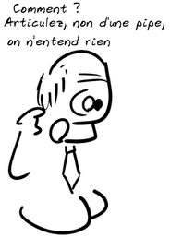
Adverse health effects…
On family life
On social life
On working life

Slide 25

Note the legislative provisions
Section 122.1 CLC- (Federal) The purpose of this Part is to prevent accidents and injury to health arising out of, linked with or occurring in the course of employment to which this Part applies
Section 122.2 CLC Preventive measures should consist first of the elimination of hazards, then the reduction of hazards and finally, the provision of personal protective equipment, clothing, devices or materials, all with the goal of ensuring the health and safety of employees

Slide 26
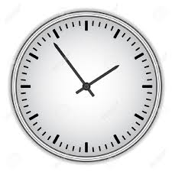
Tools to reduce noise
Adjust work schedule for daily decibel exposure (administrative actions)
An average of 16 hours of rest at 60 dBA or less is required to recover from fatigue acquired over 8 hours of exposure at 90 dBA.

Slide 27
Ear protectors
The unreliability of personal protective devices (ear defenders and earplugs) is proven
Often become the permanent solution
Do not comply with laws and regulations
Cause health problems
Create false sense of security
Deafness guaranteed!!

Slide 28
In Quebec, the SST (OHS) regulations are finally amended and will be in force in June 2023
The result of tireless union work…
Good news, including:
  Daily exposure standard increases to 85 DBA for 8 hours
  Q3 applies instead of Q5 (we’ve finally arrived in the 23rd century!)
  Employers must choose quieter machines when buying or replacing them
  Employers must implement a corrective plan following a change that may not comply with the noise standard
  Requirement to measure noise levels for "non-standard" noise

Slide 29
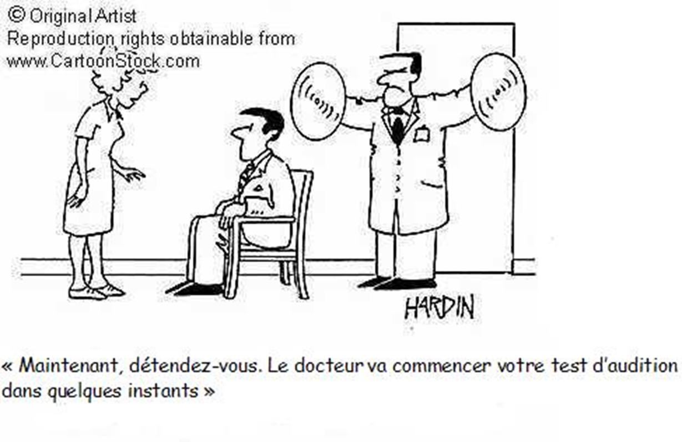
Hearing and Hearing Loss Assessment
Hearing tests

Slide 30
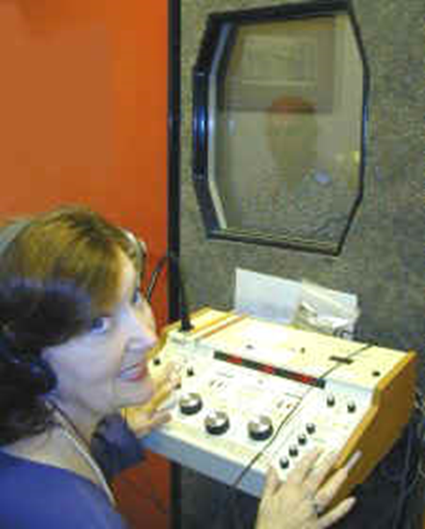
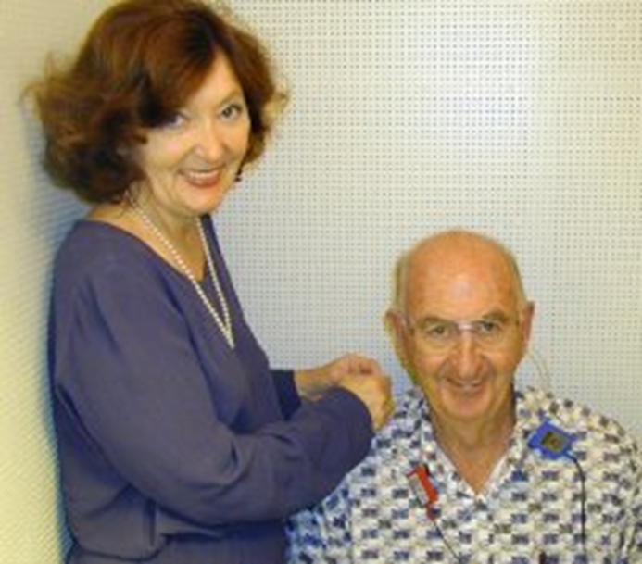
The hearing test, audiometry

Slide 31
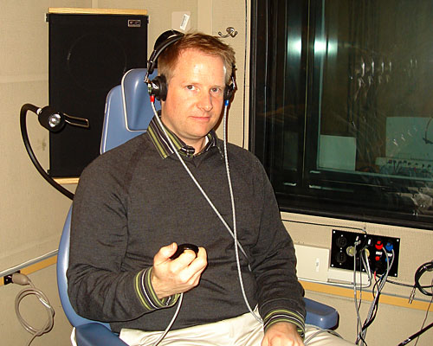
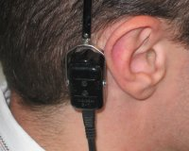
Air conduction audiometry
Bone conduction audiometry
(NIH, 2009)
(HearCom, 2009)

Slide 32
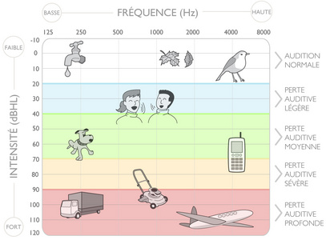
The result of an audiometry test: the audiogram
(Med-El, 2010)

Slide 33
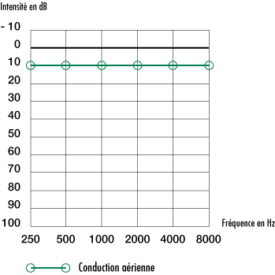
A normal audiogram in the right ear
by air conduction

Slide 34
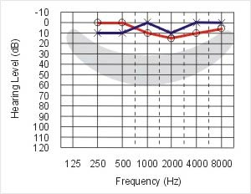
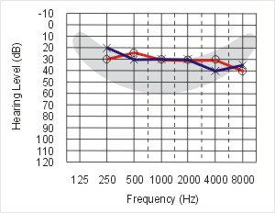
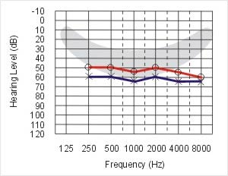
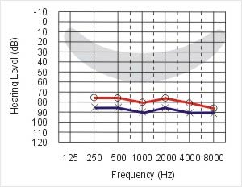
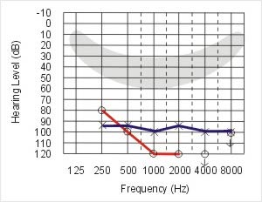
Degrees of hearing loss
(Pallant, 2001)
Normal hearing
Mild hearing loss
Moderate loss
Severe loss
Profound loss

Slide 35
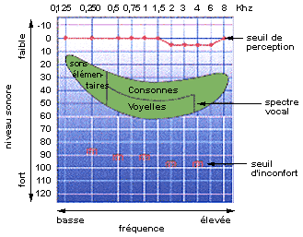
Audiogram and speech perception

Slide 36
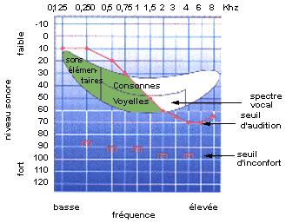
Noise-related deafness and word perception

Slide 37
Calculating hearing loss and associated compensation in Quebec in 2023
1. Average hearing thresholds are determined to be at frequencies 500, 1000, 2000 and 4000 for each ear.
2. The threshold results are rounded according to the Regulation respecting the scale of bodily injury. The minimum average is 30 dB and the maximum average is 70 dB
3. The anatomical-physiological deficit (APD) is established for each ear: the least affected and the most affected. An APD is not assigned below 30 dB.
4. Add the APD of both ears and add a percentage of PLEL (pain and loss of enjoyment of life).
5. The maximum amount of compensation is determined by the age of the person and the amount owing is calculated based on their APD and PLEL.

Slide 38
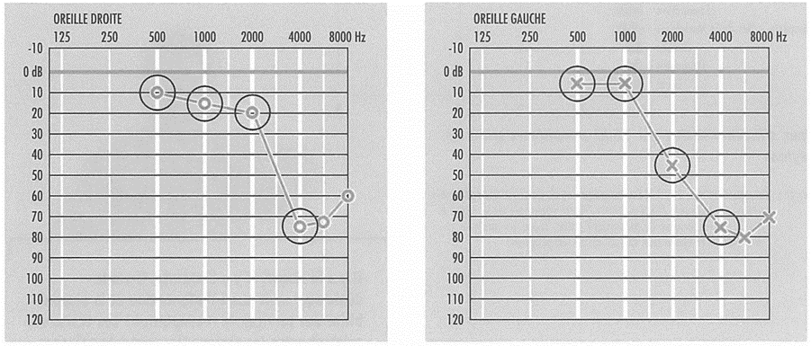
Example A: audiograms of Lisa, age 44, worked for 16 years in a noisy environment

Slide 39
Example of Lisa
(Steps 1 and 2)
1- Hearing thresholds: 5 + 5 + 45 + 75 = 130 divided by 4 = 32.5 (left ear)
2- Hearing thresholds: 10 + 15 + 20 + 75 = 120 divided by 4 = 30 (right ear)

Slide 40
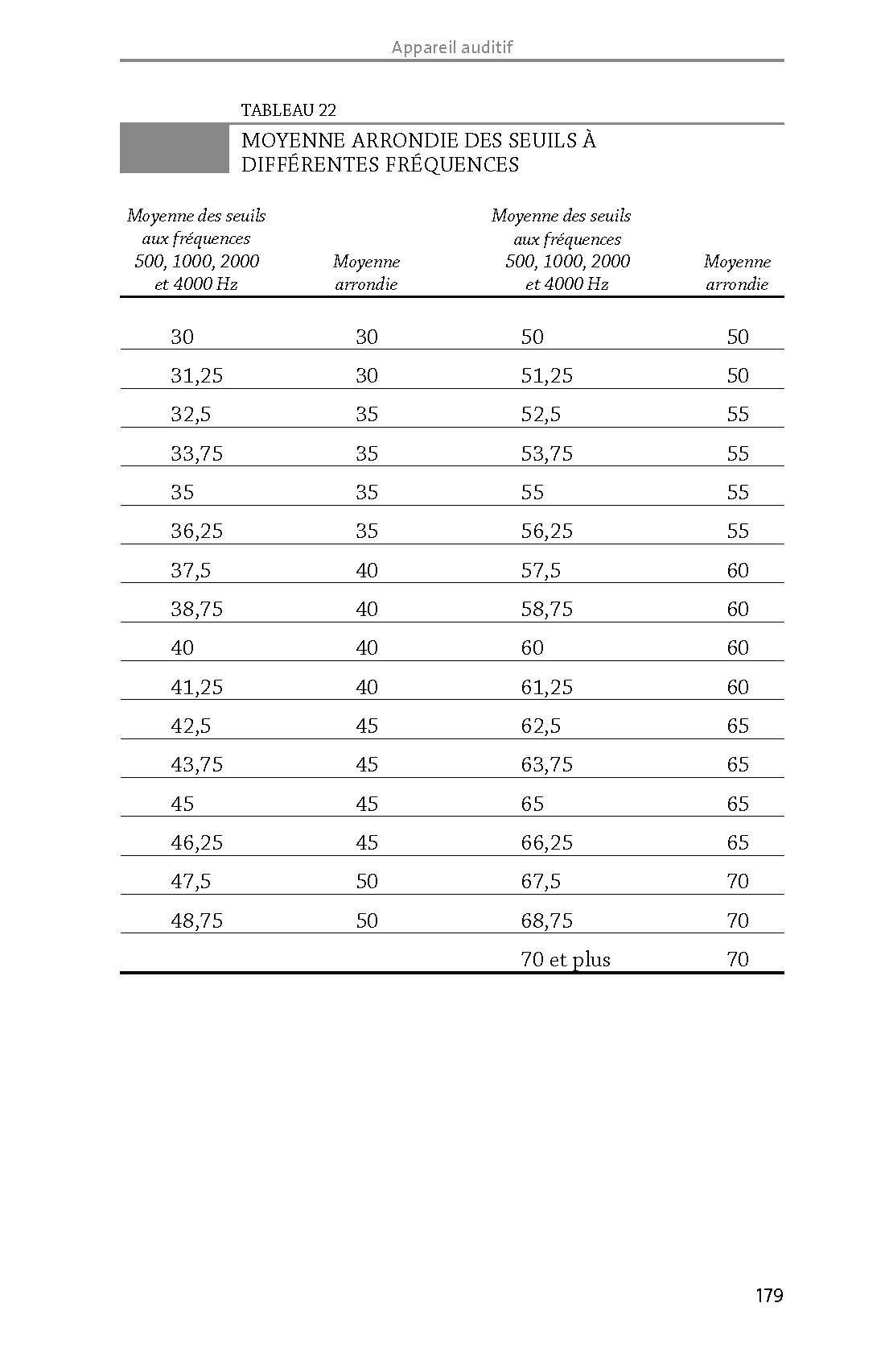
Scale of Bodily Injuries Regulation

Slide 41
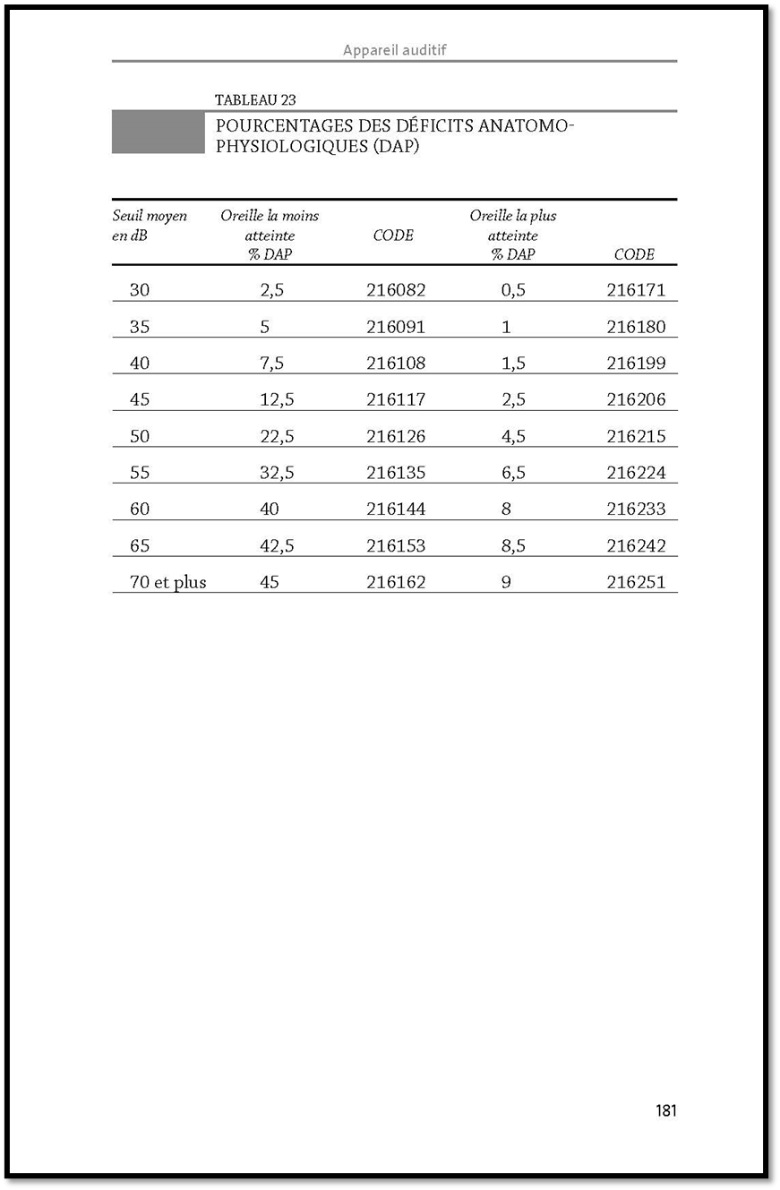
Annotated Regulations on Personal Injury Scale

Slide 42
Example of Lisa (Step 3)
Percentage of APD: 30 = 2.5 % (least affected ear)
Percentage of APD: 32.5 rounded to 35 = 1% (most affected ear)
Total APD of 3.5%

Slide 43
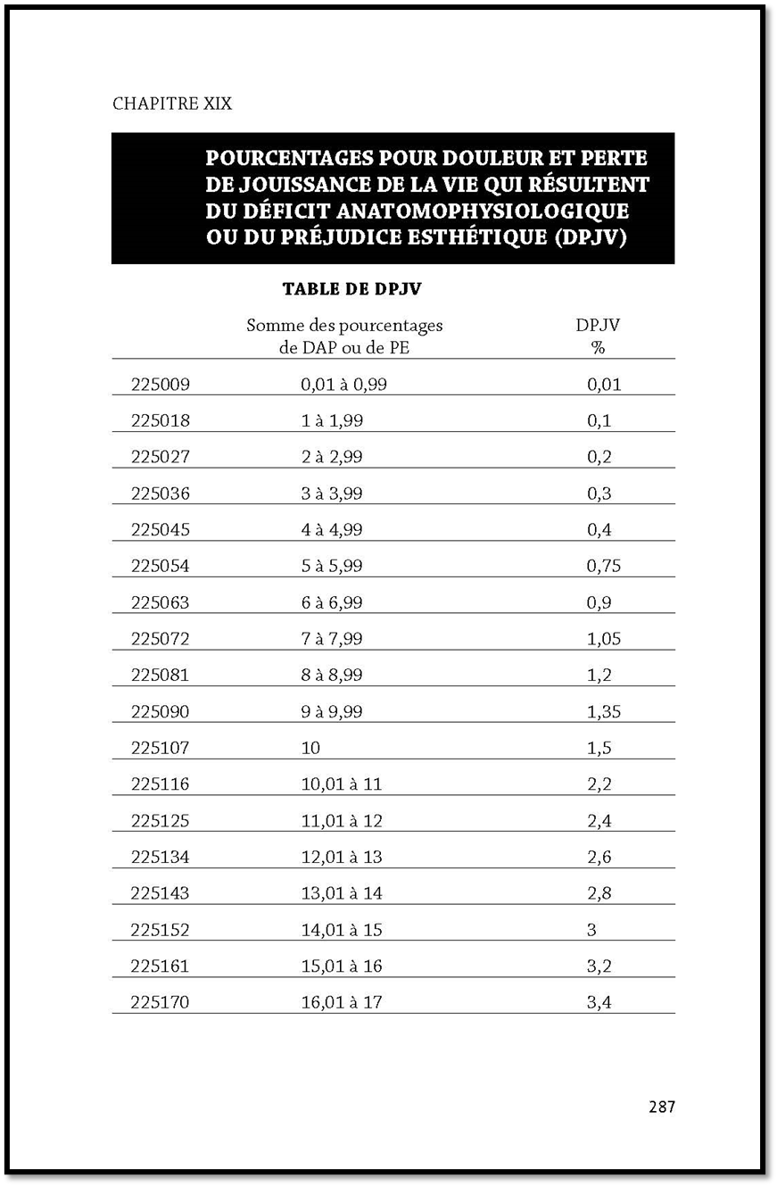
Annotated Regulations on Personal Injury Scale

Slide 44
Example of Lisa (Step 4)
Total: 2.5% + 1 % = 3.5% + 0.3%= 3.8%

Slide 45
Personal injury compensation
2023 compensation
Age | Amount | Age | Amount | Age | Amount
18 and under | $124,497.00 | 34 | $103,307.00 | 50 | $82,118.00
19 | $123,175.00 | 35 | $101,979.00 | 51 | $80,795.00
20 | $121,850.00 | 36 | $100,660.00 | 52 | $79,465.00
21 | $120,525.00 | 37 | $99,334.00 | 53 | $78,140.00
22 | $119,198.00 | 38 | $98,014.00 | 54 | $76,815.00
23 | $117,878.00 | 39 | $96,686.00 | 55 | $75,494.00
24 | $116,554.00 | 40 | $95,366.00 | 56 | $74,167.00
25 | $115,230.00 | 41 | $94,035.00 | 57 | $72,845.00
26 | $113,907.00 | 42 | $92,713.00 | 58 | $71,518.00
27 | $112,582.00 | 43 | $91,390.00 | 59 | $70,196.00
28 | $111,257.00 | 44 | $90,065.00 | 60 | $68,872.00
29 | $109,932.00 | 45 | $88,738.00 | 61 | $67,542.00
30 | $108,606.00 | 46 | $87,411.00 | 62 | $66,222.00
31 | $107,279.00 | 47 | $86,534.00 | 63 | $64,897.00
32 | $105,956.00 | 48 | $84,772.00 | 64 | $63,572.00
33 | $104,633.00 | 49 | $83,445.00 | 65 and over | $62,252.00

Slide 46
Example of Lisa (Step 5)
$90,065.00 (Lisa is 44 years old) X 3.8 % = $3422.47

Slide 47
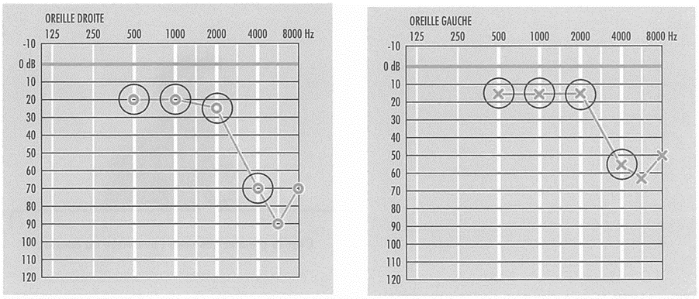
Example B: audiograms of John, age 50, worked for 29 years in a noisy environment

Slide 48
Example of John
(Steps 1 and 2)
1-15 + 15 + 15 + 55 = 100 divided by 4 = 25 (left ear)
2-20 + 20 + 25 + 70 = 135 divided by 4 = 33.75 (right ear)

Slide 49
Scale of Bodily Injuries Regulation

Slide 50
Scale of Bodily Injuries Regulation

Slide 51
Example of John
(Step 3)
25 = 0% (least affected ear)
33.75 rounded to 35 = 1% (most affected ear)
Total ADP of 1 %

Slide 52
Scale of Bodily Injuries Regulation

Slide 53
Example of John
(Step 4)
0% + 1 % = 1% + 0.1%= 1.1%

Slide 54
Personal injury compensation
2023 compensation
Age | Amount | Age | Amount | Age | Amount
18 and under | $124,497.00 | 34 | $103,307.00 | 50 | $82,118.00
19 | $123,175.00 | 35 | $101,979.00 | 51 | $80,795.00
20 | $121,850.00 | 36 | $100,660.00 | 52 | $79,465.00
21 | $120,525.00 | 37 | $99,334.00 | 53 | $78,140.00
22 | $119,198.00 | 38 | $98,014.00 | 54 | $76,815.00
23 | $117,878.00 | 39 | $96,686.00 | 55 | $75,494.00
24 | $116,554.00 | 40 | $95,366.00 | 56 | $74,167.00
25 | $115,230.00 | 41 | $94,035.00 | 57 | $72,845.00
26 | $113,907.00 | 42 | $92,713.00 | 58 | $71,518.00
27 | $112,582.00 | 43 | $91,390.00 | 59 | $70,196.00
28 | $111,257.00 | 44 | $90,065.00 | 60 | $68,872.00
29 | $109,932.00 | 45 | $88,738.00 | 61 | $67,542.00
30 | $108,606.00 | 46 | $87,411.00 | 62 | $66,222.00
31 | $107,279.00 | 47 | $86,534.00 | 63 | $64,897.00
32 | $105,956.00 | 48 | $84,772.00 | 64 | $63,572.00
33 | $104,633.00 | 49 | $83,445.00 | 65 and over | $62,252.00

Slide 55
Example of John
(Step 5)
$82,118.00 (John is 50) X 1.1 % = $903.30
Minimum amount set by section 86 of the AIAOD is $1,244.00

Slide 56

How to initiate a medical file?
1- Meet with your doctor and explain your hearing problems
2- Your doctor will refer you to an ENT specialist
3- The ENT will refer you to an audiologist for a test and an audiogram
4- ENT evaluation and medical opinion
5- Your file is returned to your attending physician

Slide 57

To open a file and submit a claim to the CNESST, you must collect and transmit the following documents:
1-Worker claim
2-Medical certificate
3-Appendix to the worker’s claim
4-Relevant noise measurements (if possible)
5-Hearing evaluation report (audiogram)
6-Medical evaluation report

Slide 58
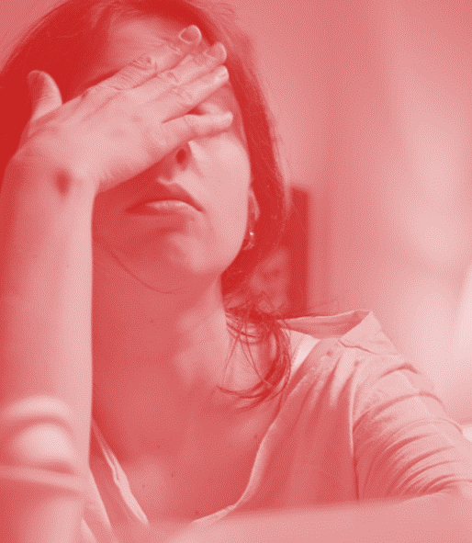
Infra- or supra-threshold?
An infra-threshold result opens the way to social and professional rehabilitation
A supra-threshold result adds a rehabilitation check based on the seriousness of your injury

Slide 59
The new regulation respecting occupational diseases
This Regulation determines, in Schedule A, diseases and the specific conditions related to them for the purposes of the application of the presumption of occupational disease provided for in section 29 of the Act respecting industrial accidents and occupational diseases (chapter A-3.001).
It also determines, for the purposes of section 28.1 of the Act, the eligibility criteria for a claim for a disease whose diagnosis is noise-induced hearing loss.
SECTION IV — DISEASES CAUSED BY PHYSICAL AGENTS
DISEASES SPECIAL CONDITIONS
Hearing loss caused by noise Work involving exposure to excessive noise

Slide 60
Conclusion
Investing in prevention works to the advantage of employers
A recent study concluded that investments in safety and health provide direct microeconomic benefits at a POR ratio of 2.2
Specifically, businesses can expect a potential return of €2.20 per euro (or any other currency) invested in prevention, per year and per employee
The Auditor General of Quebec explained in his 2019 report that the return is 7 to 10 times per dollar invested in prevention

Slide 61
Conclusion

Slide 62
Conclusion
Maintain our workplace noise reduction campaigns
The Decibel Alert course provides an action plan and pays off when we reach our goals
We must address the issue of prevention...in order to improve the catastrophic situation in which we find ourselves.

