Slide 1

Violence and Harassment
Andrea Peart
National Health and Safety Officer
PSAC - AFPC

Slide 2

A MOMENT OF RECOGNITION FOR ALL OF YOUR WORK

Slide 3
Menu
Violence and Harassment
Committees and Communicating

Slide 4

What Will the FUTURE HOLD?
Notes:
Will we stay in this pandemic limbo forever? Will this become endemic?
Will we have normalized COVID-19 risks? Will some of us work hybrid models?
How are hazards, risks, forgotten maintenance, accidents and injuries reported to H&S committees when you don’t see each other?
How are members reminded about health and safety? How do they participate?
Violence and Harassment cases are down, but what will the future hold, especially when there is a new process? We had the training but was the knowledge demonstrated?
Can we fix the systemic issues with harassment and violence at DND?

Slide 5
“The best way to predict the future is to invent it.”
In 1971 at the Xerox Palo Alto Research Center (Xerox PARC), the computer scientist Dr. Alan Kay famously said,

Slide 6
OBJECTIVES:
Ensure the employer is sufficiently preventing violence and harassment, ensure we feel confident to make recommendations regarding risk factors that contribute to harassment and violence, understand the roles of the various parties in relation to harassment and violence in the workplace and better understand what it really means to respond, resolve and support victims of harassment and violence. Support and inspire our health and safety committees.
Understand that our primary goal is to make recommendations.
Embrace the future of work and most importantly embrace our role as H&S activists.

Slide 7

Violence and Harassment
Violence and Harassment
Committees and Communicating

Slide 8
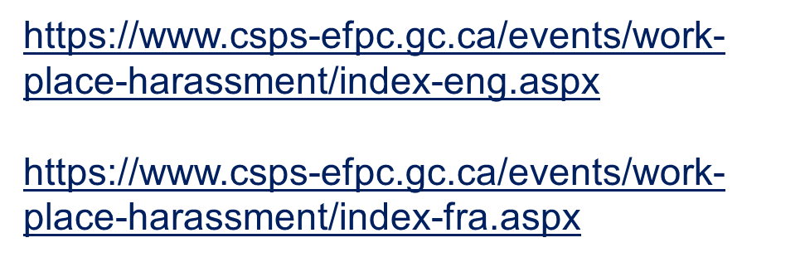
Violence and Harassment:
A new system for violence and harassment came into force January 1st, 2021.
While lots of training happened, however much of the knowledge wasn’t demonstrated as case numbers are down.
We must ensure the employer is sufficiently preventing violence and harassment.
We must ensure we feel confident to make recommendations regarding risk factors that contribute to harassment and violence.
Clearly understand the roles of the various parties in relation to harassment and violence in the workplace and better understand what it really means to respond, resolve and support victims of harassment and violence.
Tools available to you:
- Sample Statement of Work
- Flow Chart
- FAQ
- Domestic Violence guide
- Risk Assessment Tool
- Regulations, IPG…
Notes:
Andrea – Make sure to mention, the regulations, the IPG
PLUS the PSAC tools which are so amazing the employer is using them, the NJC and the event April 4th

Slide 9


Slide 10
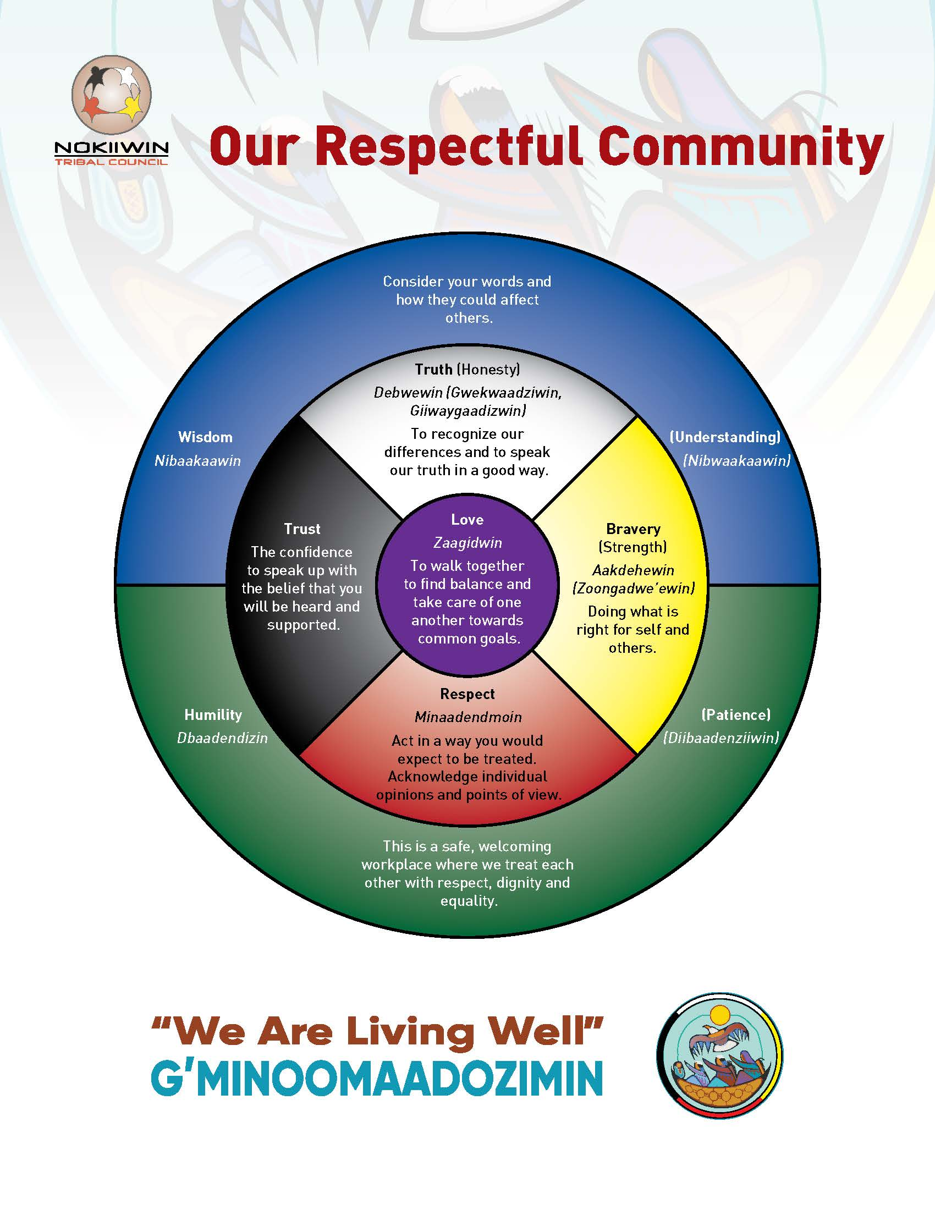

Slide 11
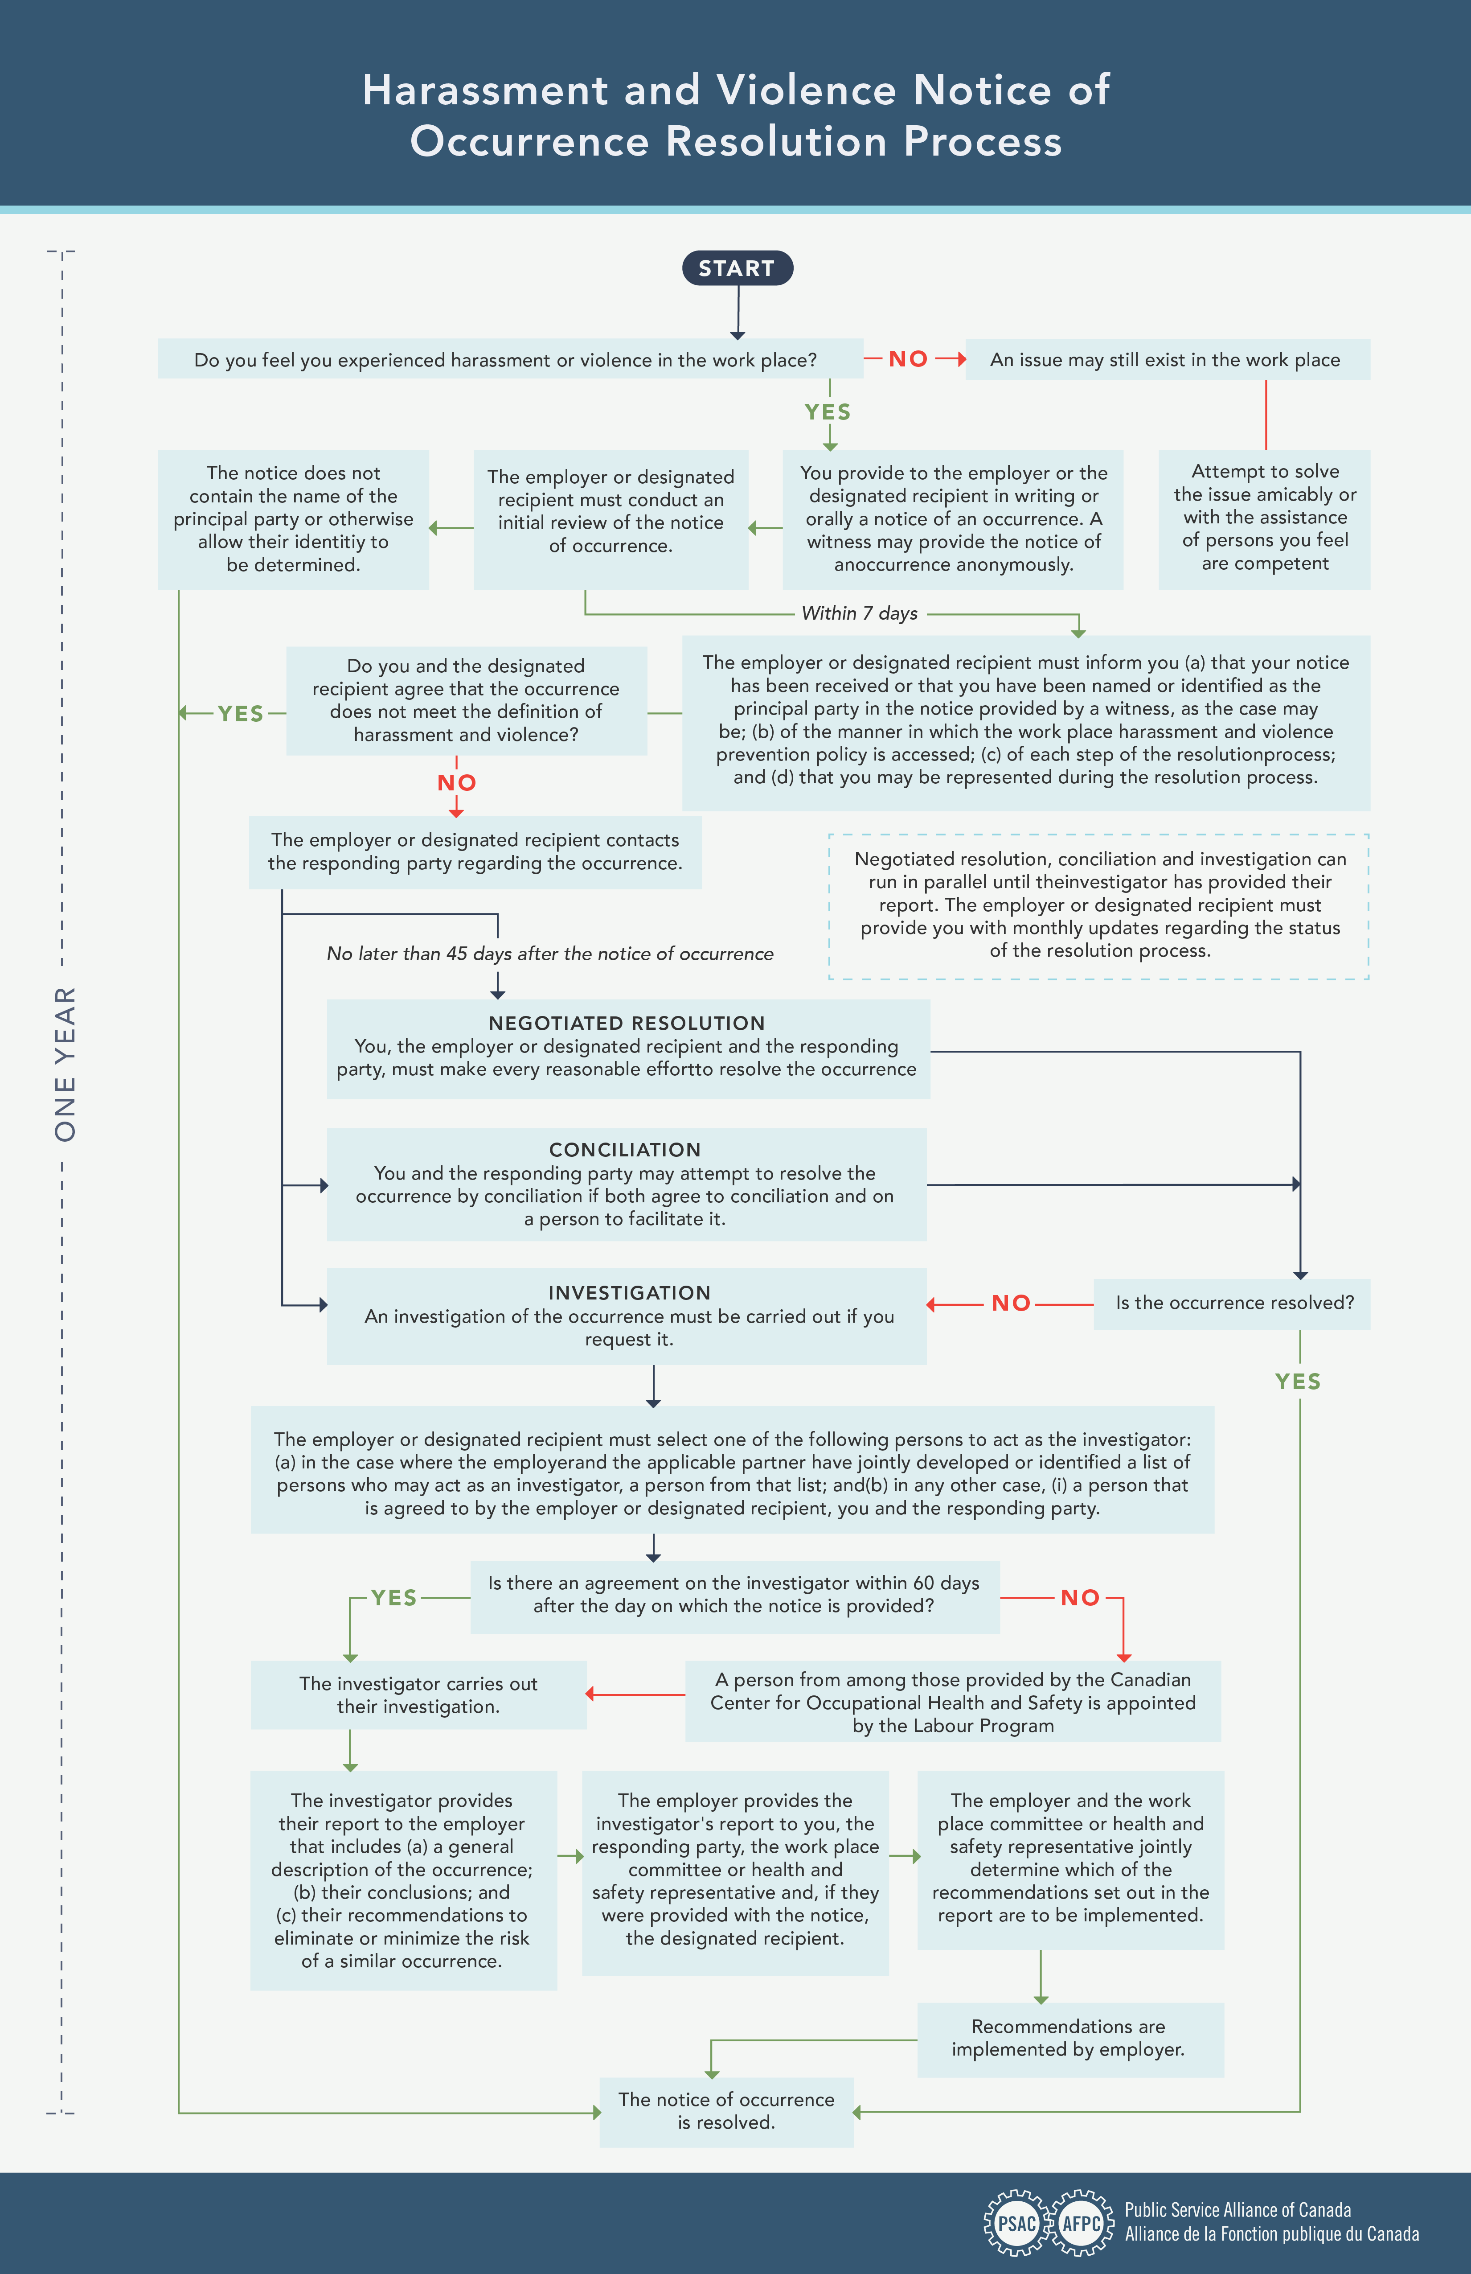

Slide 12
Employer Responsibiliites
Violence and Harassment
1. Protect Employees by preventing harassment and violence
2. Establish and communicate policies with the participation of the policy committee. This includes developing a list of potential invesgitators, jointly with the policy committee.
3. Have a plan for both the short and medium term to prevent harassment and violence, receive notices (designated recipient), support conciliation and implement investigator recommedations. Equity considerations can’t be ignored.
4. Plan and provide adequate training, plus micro-learning.
5. Help people stay informed on everything they need to know.
- where is the workplace
- how to file a complaint
- understanding the process and their rights
- training opportunities
- health and safety risk assessments and inspections
- flow chart

Slide 13
VIOLENCE AND HARASSMENT Conclusions
The employer can’t do this alone.
Health and Safety committees, representatives and policy committees have an important role to play.
Make recommendations
- be creative,
- think about how information is shared, and
- think about preventing, not only responding and supporting workers.
There are resources out there, use them and share them.
Consider helping the employer in promoting and disseminating information and don’t neglect micro-learning.

Slide 14
Committees and Communicating
Violence and Harassment
Committees and Communicating

Slide 15
Workplace Committees and Representatives’ Responsibilities
Plus Communicating!
Deal with local OHS complaints
Make recommendations to management
Inspect the workplace monthly
Maintain adequate records
Participate in inquiries and investigations
Participate in the implementation and monitoring of OHS policies and programs

Slide 16
COMMITTEES AND COMMUNICATING
- There will be new processes and new ways of collectively ensuring things get done.
- While the role of committees is evolving, the actual responsibilities are not changing.
- Communicating with H&S committees and members who are not consistently in the workplace will be different.
- Consider formalized ways to work in teams or shifts to reflect work schedules. Consider similar solutions for similar problems e.g. multiple shifts for fire wardens, apply the same approach to first aid or participating in incident investigations.

Slide 17
CoMMITTEES and COMMUNICATING
Conclusions
Be creative and strategic in your recommendations.
On key issues remember to ask questions.
For the ongoing work relating to violence and harassment, support the use of a complex evaluation tool, consider the tools provided and use events, or new tools as a way to open up the conversation.
There is a pattern here, the conclusions were very similar for Violence and Harassment as well as Committees and Communicating; and the conclusions are similar because this is the path forward.

Slide 18
Violence and Harassment:
Health and Safety committees, representatives and policy committees have an important role to play

Slide 19
THANKS!
Andrea Peart
National Health and Safety Officer
PSAC - AFPC

Slide 20
Questions?

